Slide 1



BEYOND REDUCE, REUSE, RECYCLE
ECO-ACTION FOR A HEALTHY LIVING

Slide 2
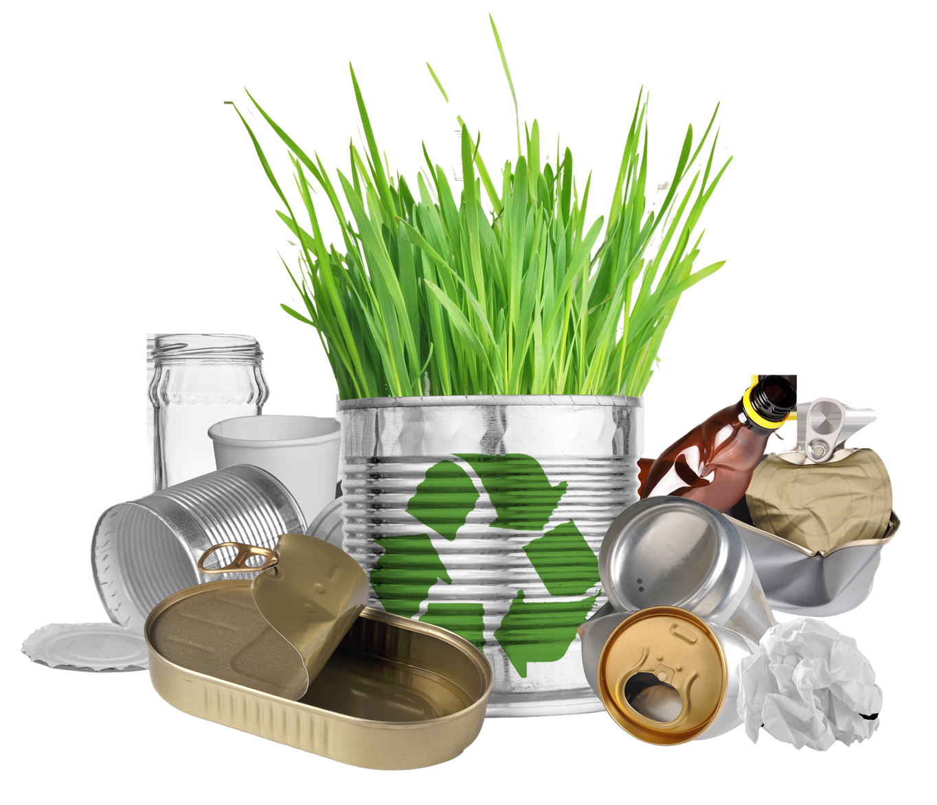

WHAT WE‘LL COVER
01
INTRODUCTION
02
THE ECO-ACTION
03
LIVING A GREENER LIFESTYLE

Slide 3

INTRODUCTION
The 3Rs—Reduce, Reuse, and Recycle—help minimize waste, conserve resources, and protect the environment. Reducing consumption lowers pollution, reusing items extends their lifespan, and recycling cuts landfill waste. Practicing the 3Rs fights climate change and supports a sustainable future

Slide 4
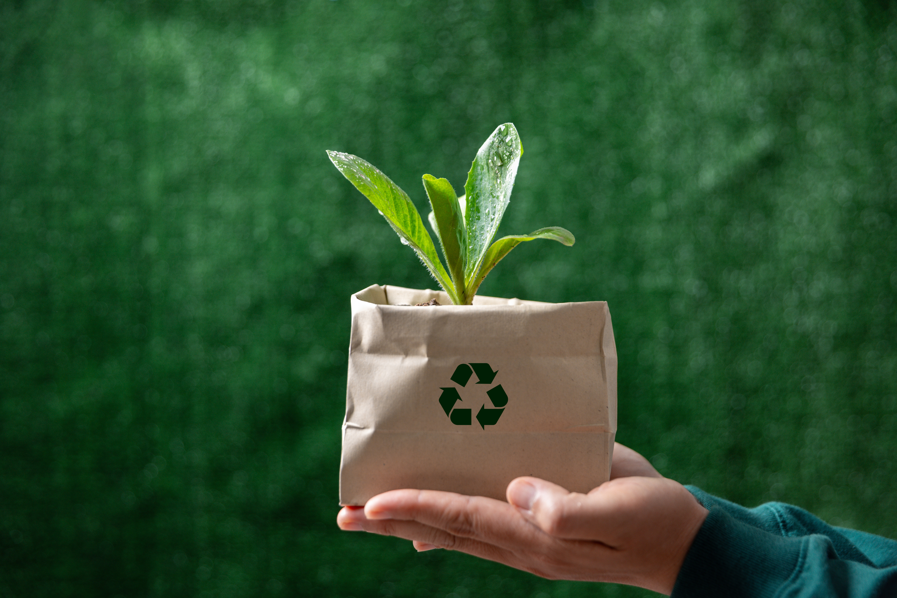
DISADVANTAGES OF THE REDUCE, REUSE, RECYCLE METHOD
Although the 3Rs (Reduce, Reuse, Recycle) offer many benefits, they also have drawbacks. Reducing consumption is difficult due to habits and dependence on new products. Reusing requires high awareness and may not be feasible with damaged items. Recycling involves costs and complex processes, especially when sorting is inefficient. The 3Rs are just one part of a long-term solution for environmental protection.

Slide 5


A HOLISTIC APPROACH
While the 3Rs (Reduce, Reuse, Recycle) are vital, adding Rs like Refuse, Repair, and Repurpose enhances sustainability. It's important to instill in future generations a sense of responsibility, resourcefulness, and persistency in facing challenges. By nurturing these values, we empower individuals to protect the environment and build a sustainable future.

Slide 6
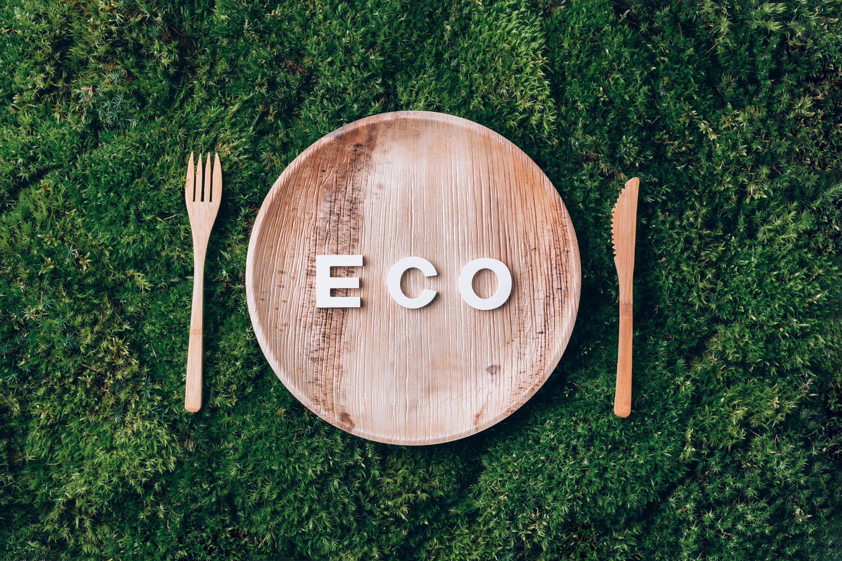
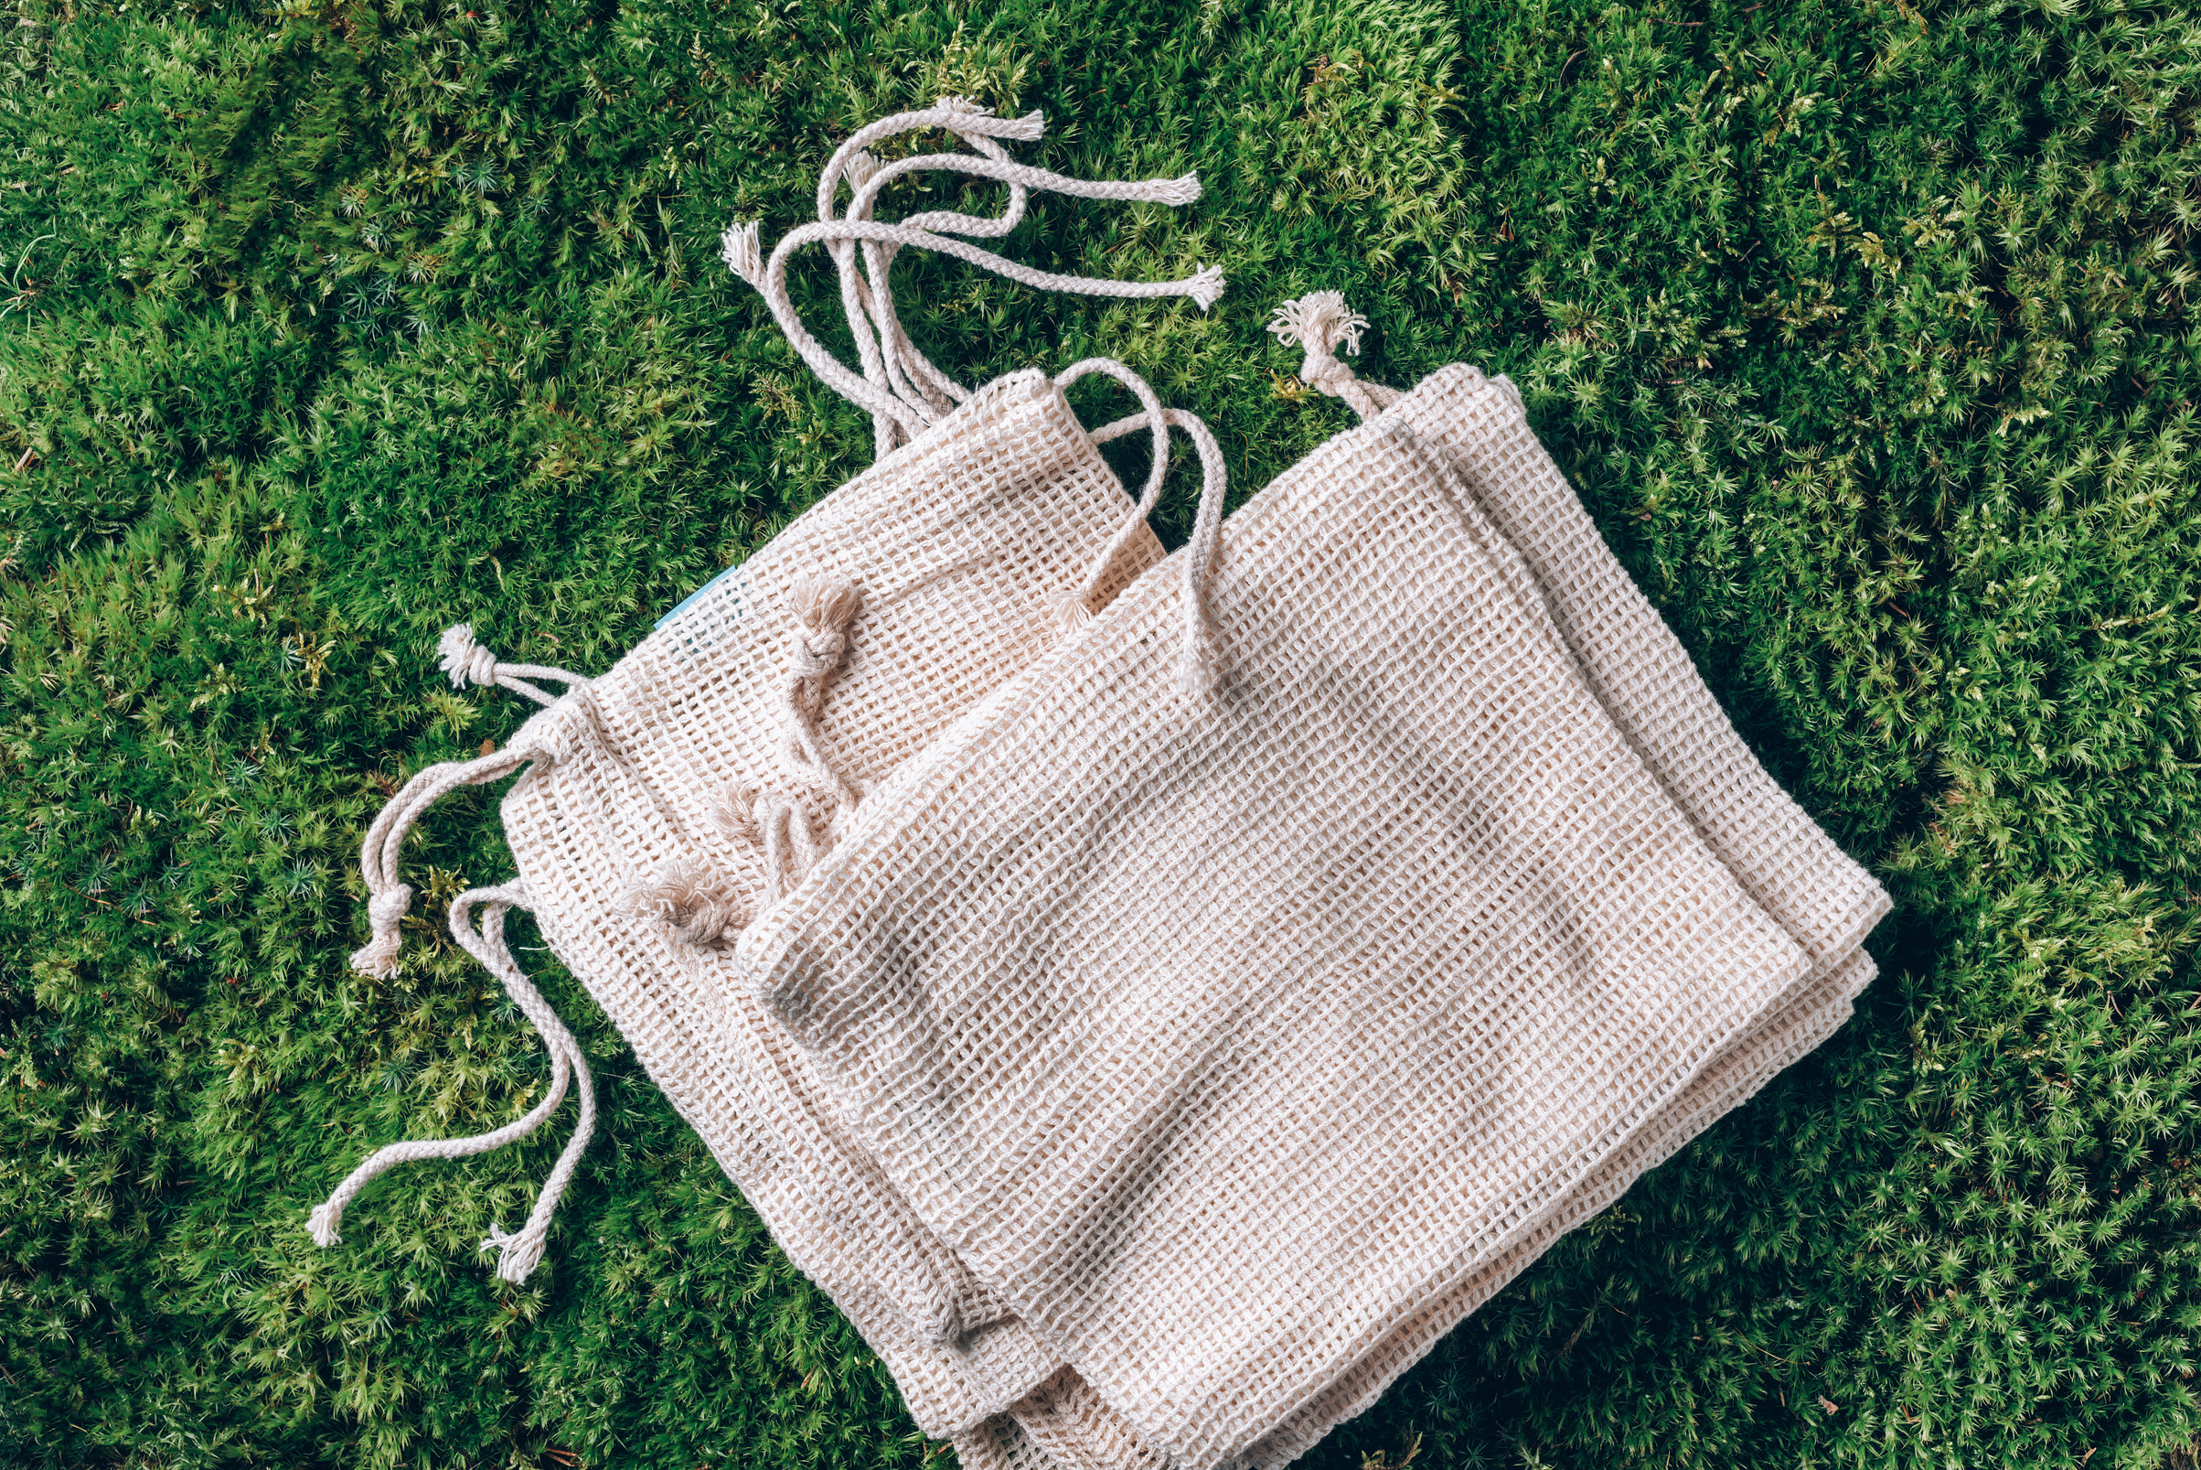


THE ECO-ACTION
REFUSE THE UNNECESSARY
We need to eliminate single-use items and wasteful consumption, for examples, use reusable water bottles and shopping bags, as well as avoiding impulse purchases.

Slide 7
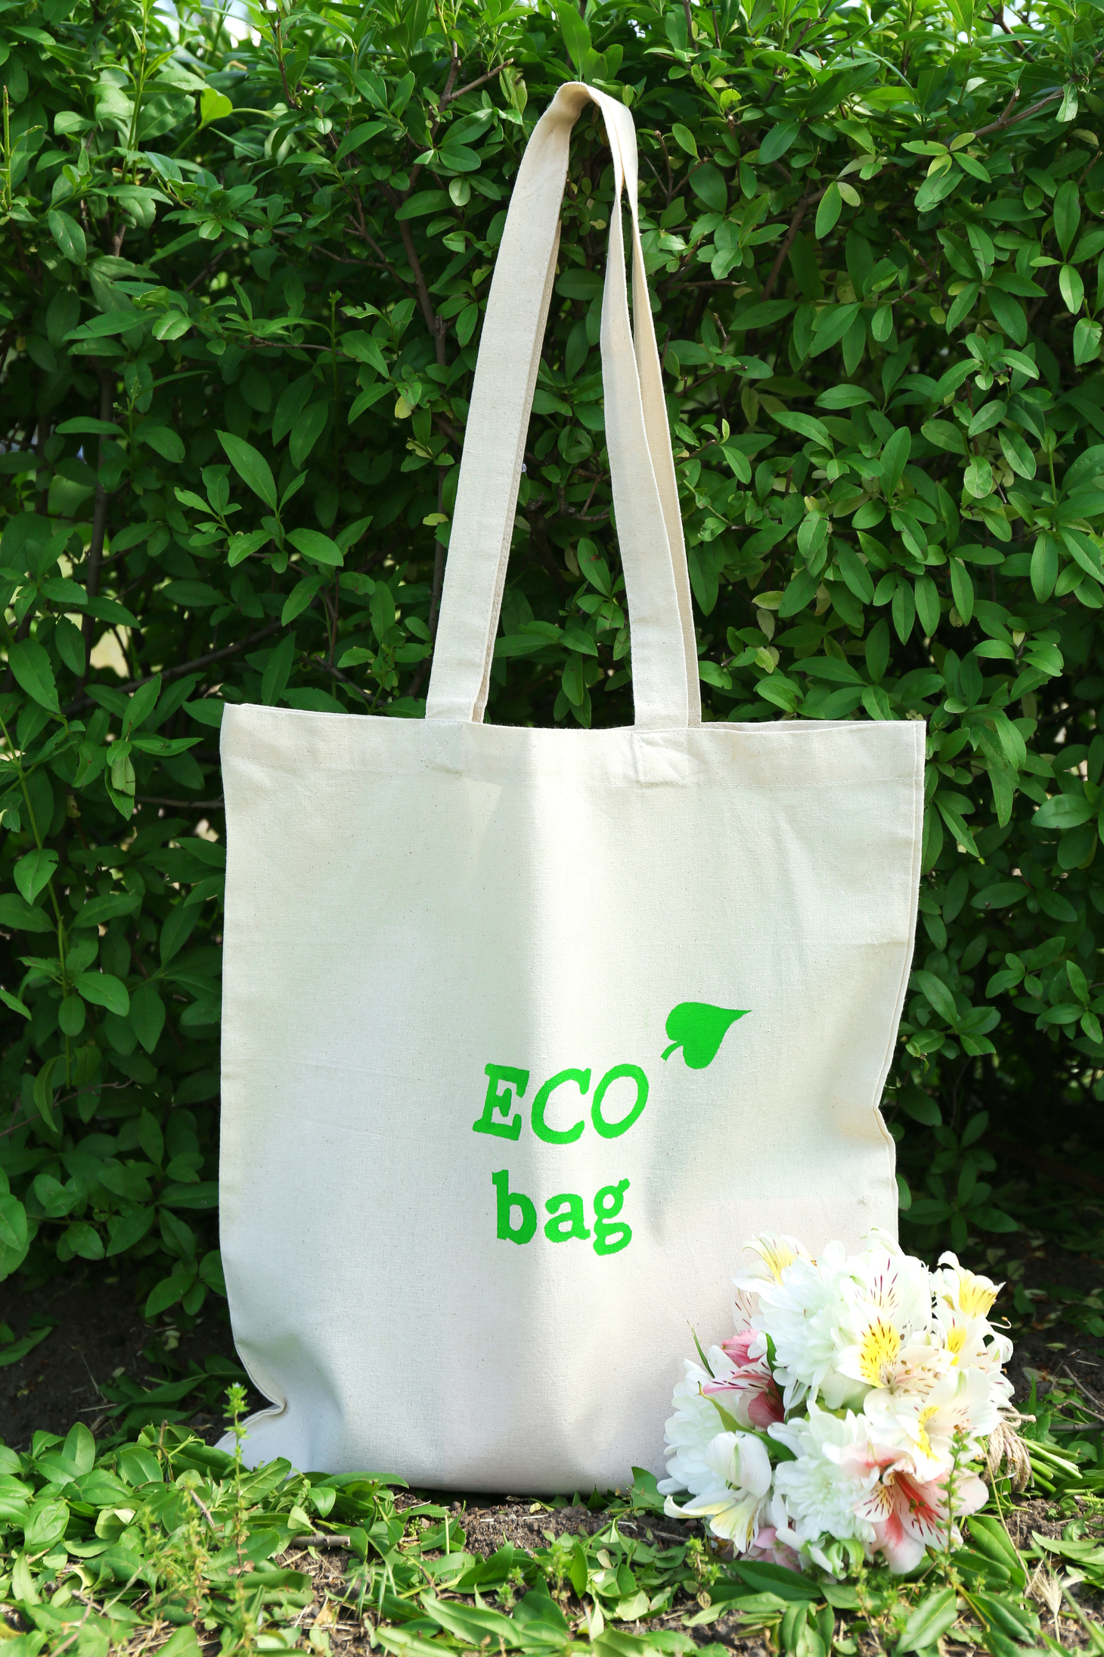
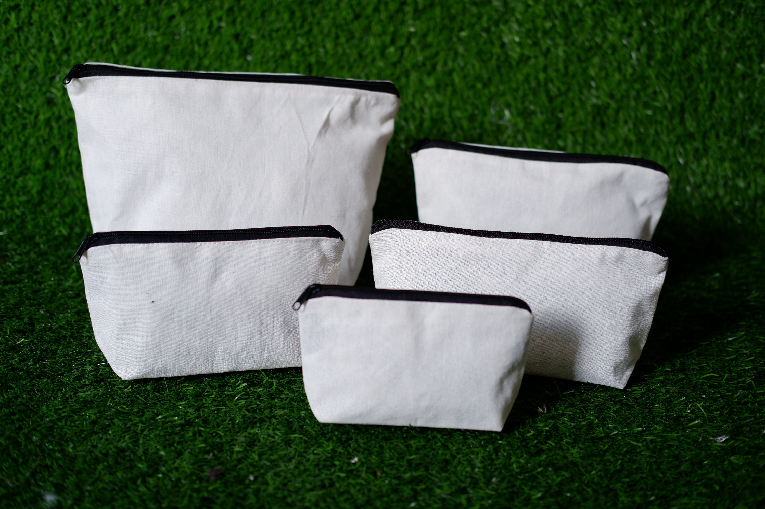
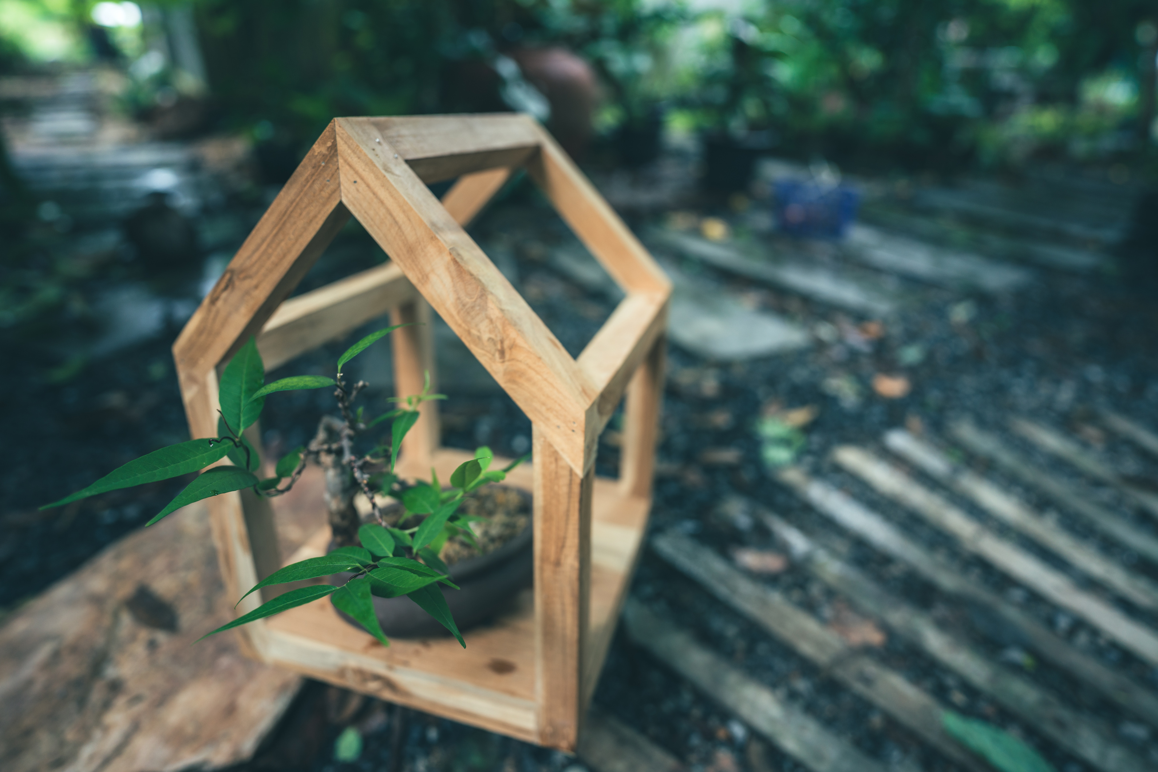
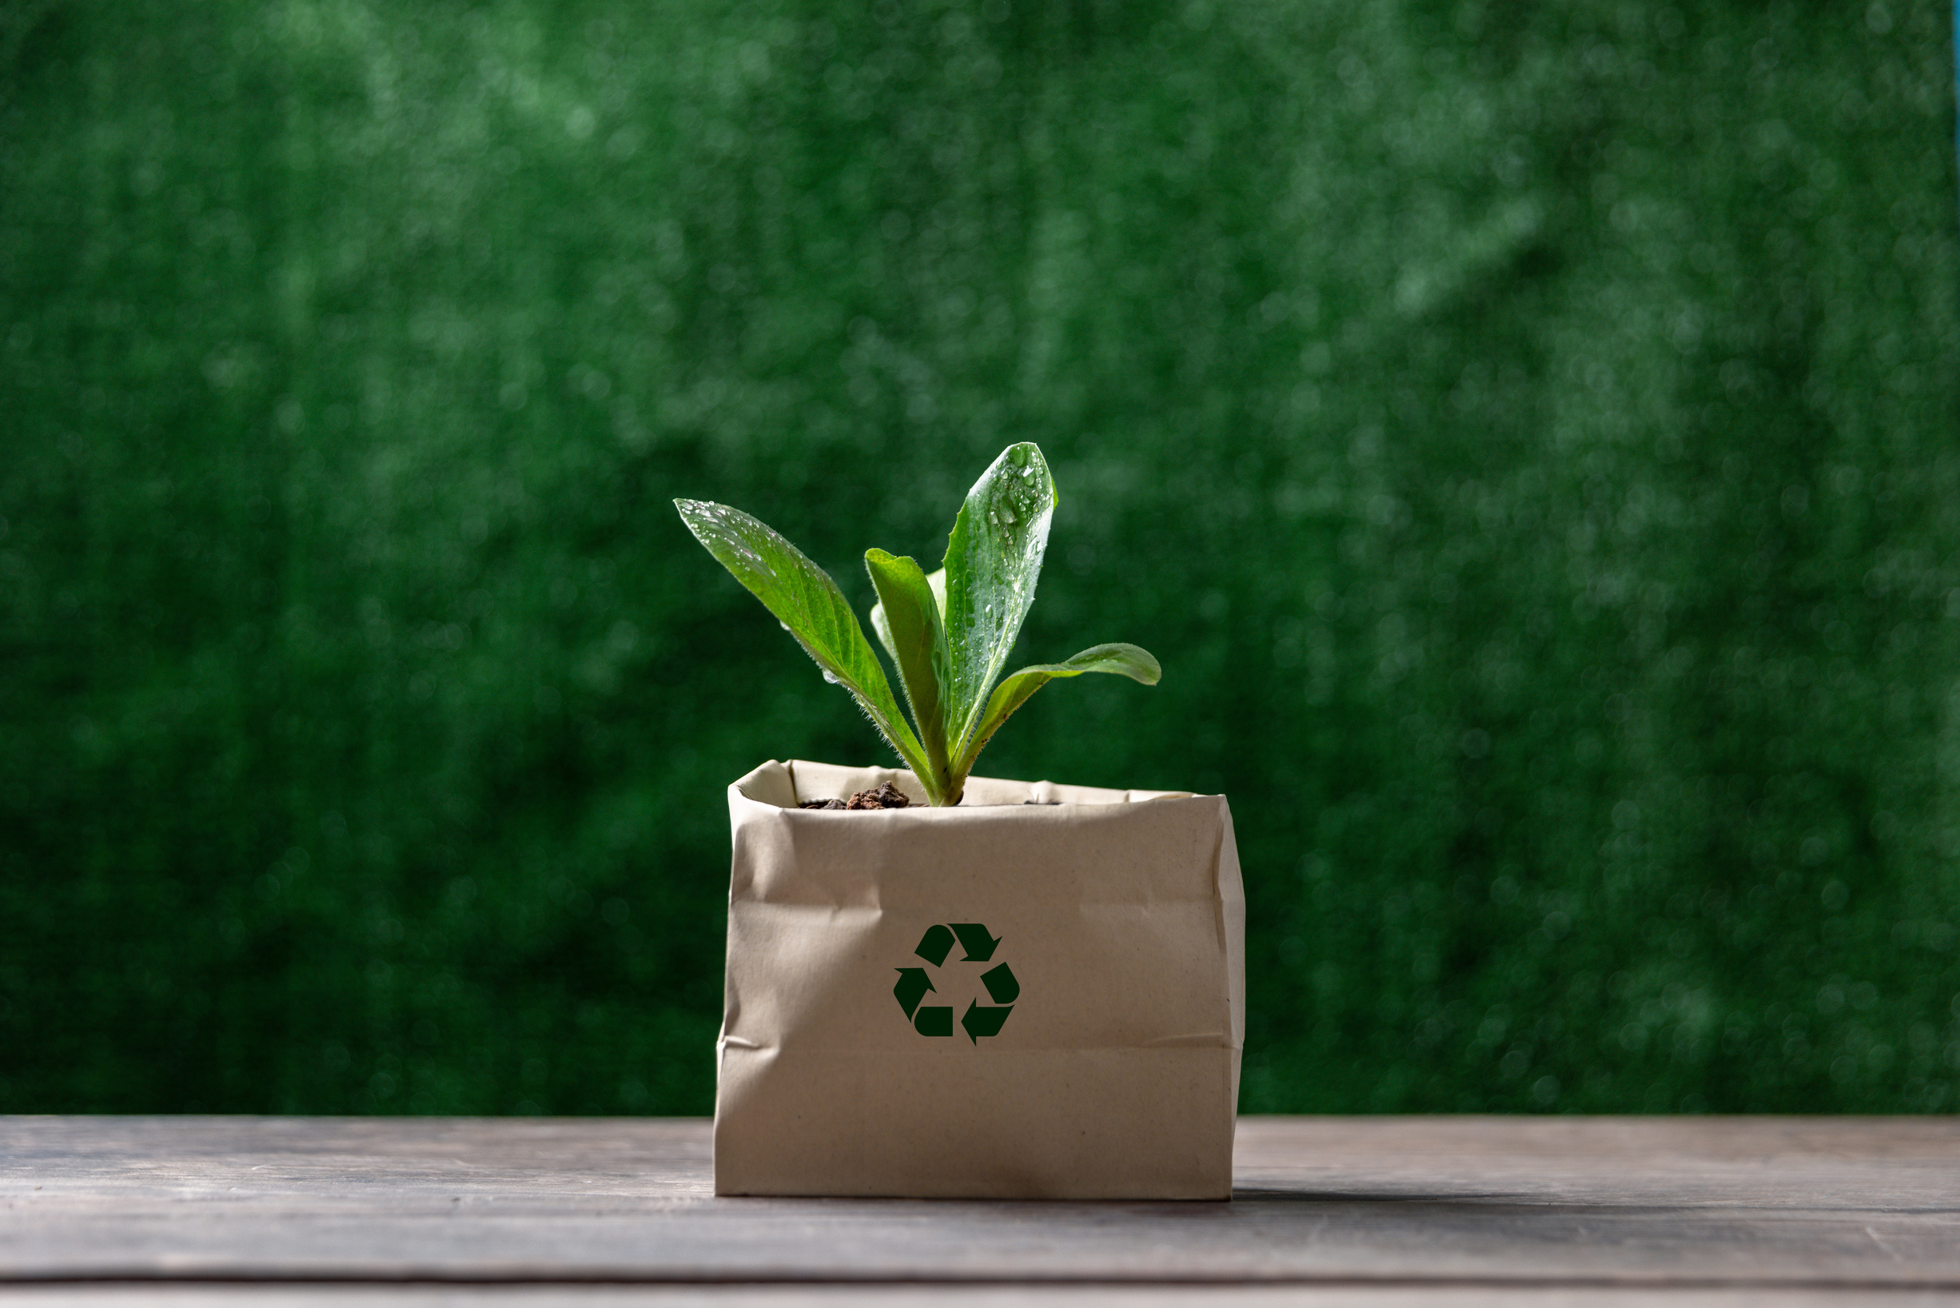
REPURPOSE WITH CREATIVITY
Introduce the concept of "repurposing" or "upcycling" to give outdated items new life. Give examples of ways to reuse goods, such as transforming worn-out outfits into a tote bag or pet bed, or cutting plastic bottles in half to create hanging planters.

Slide 8
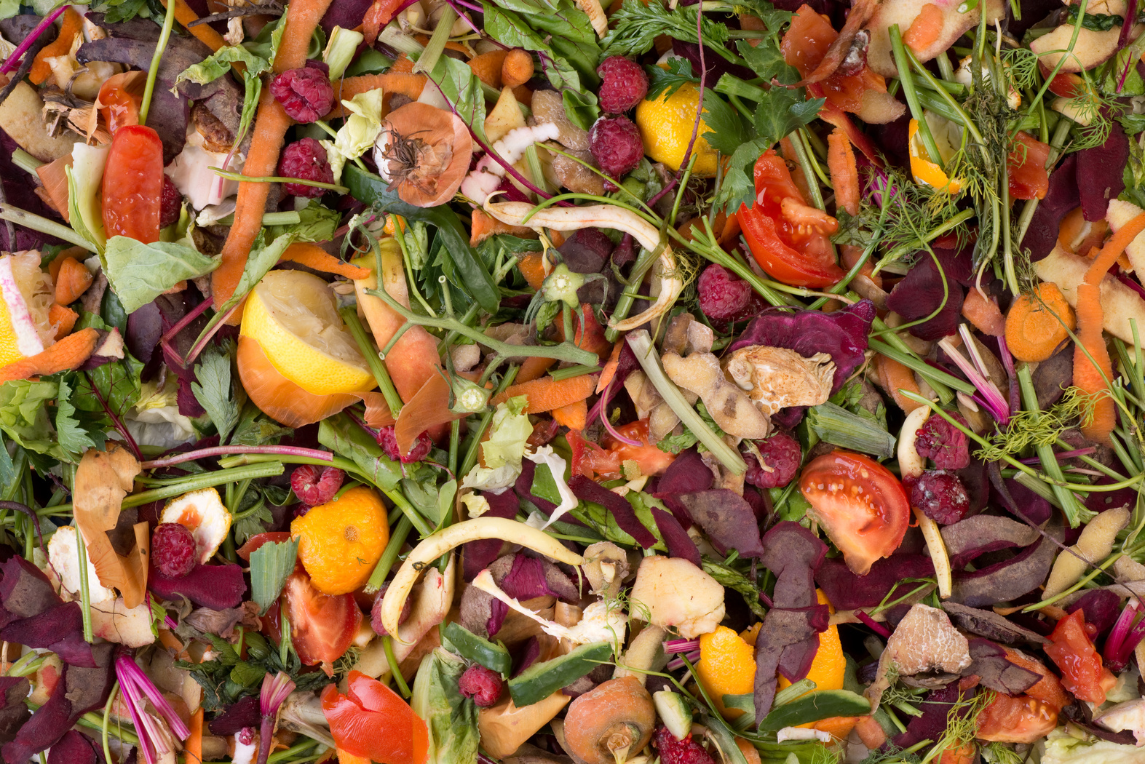
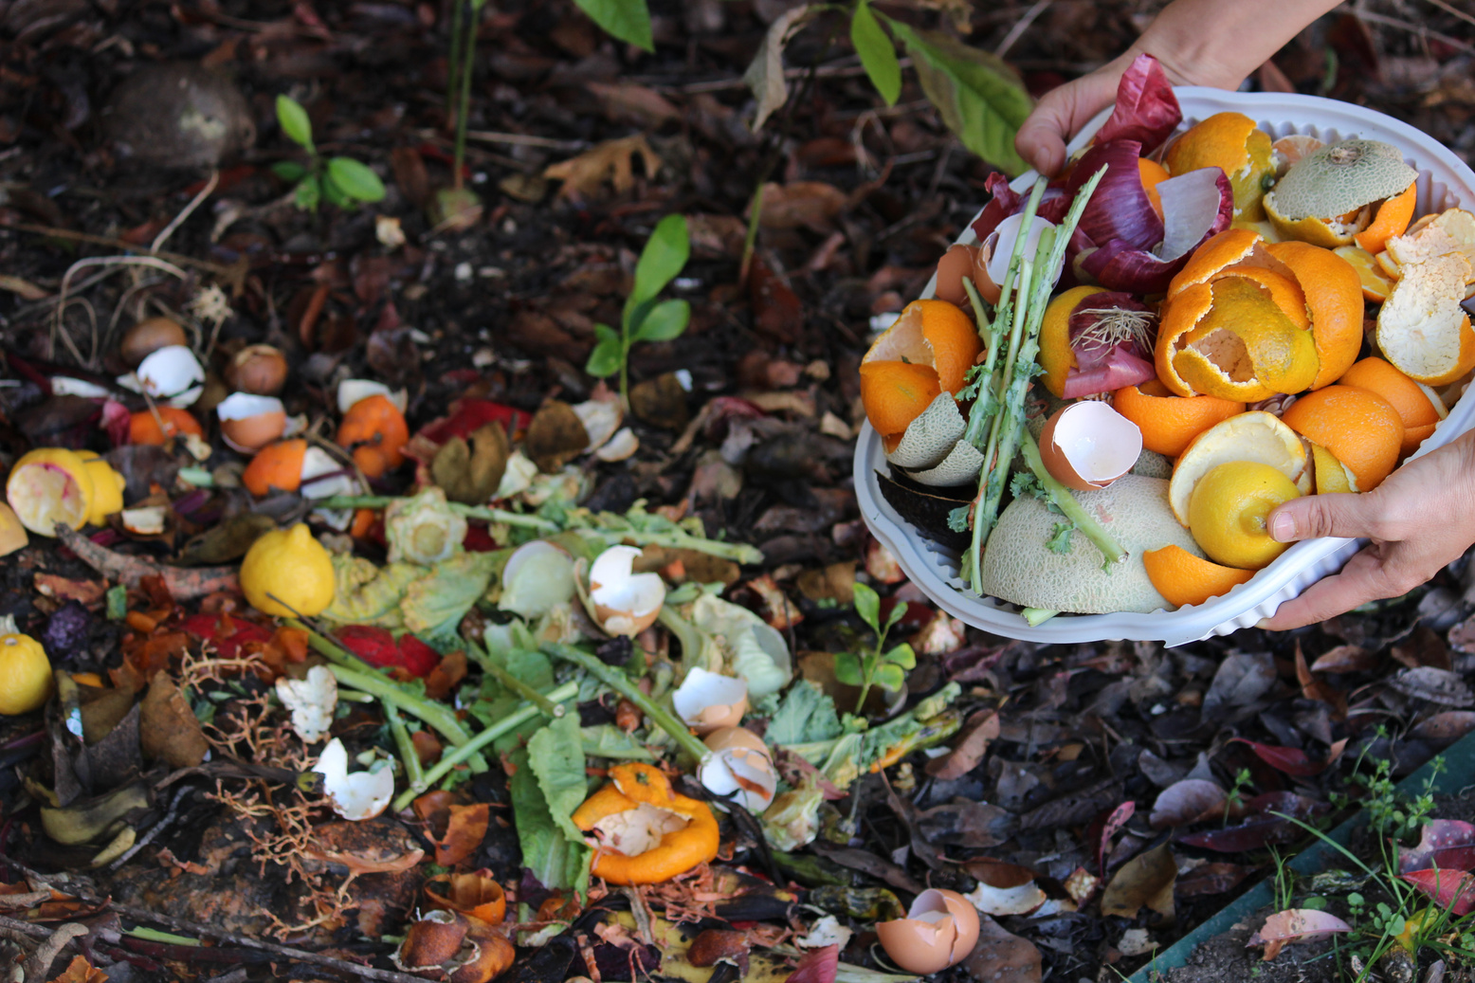
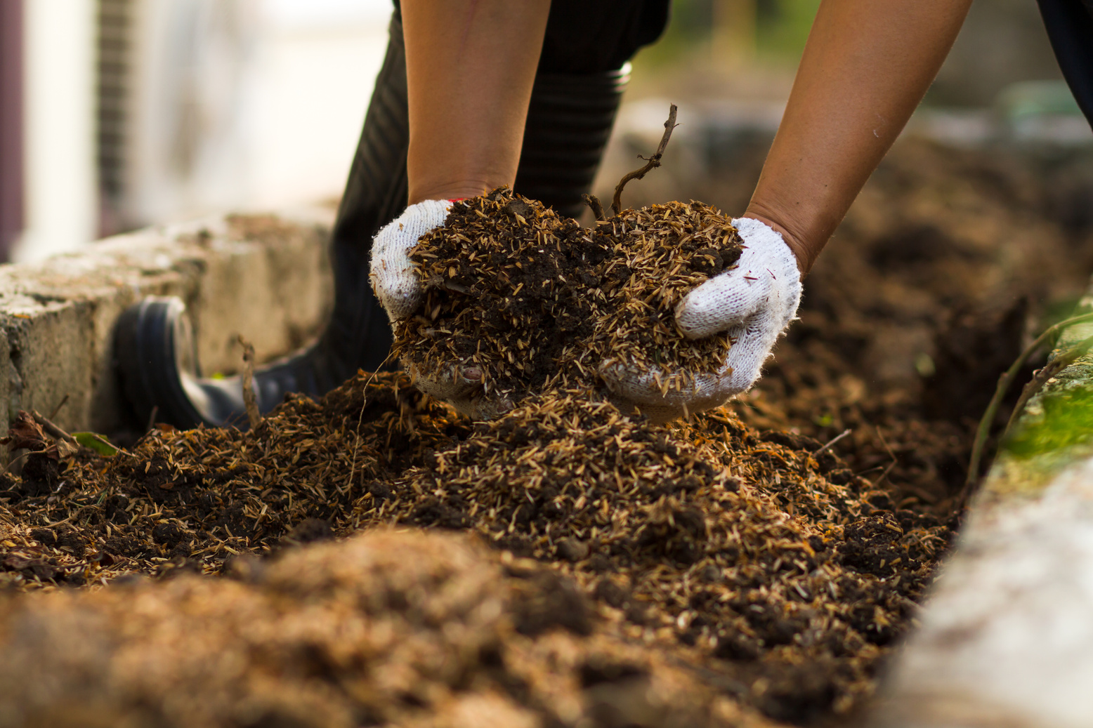
ROT WHAT YOU CAN'T USE
Discuss how composting food scraps and yard trash helps to minimize landfill waste while also creating nutrient-rich soil. Explain briefly how the garbage is composted.

Slide 9
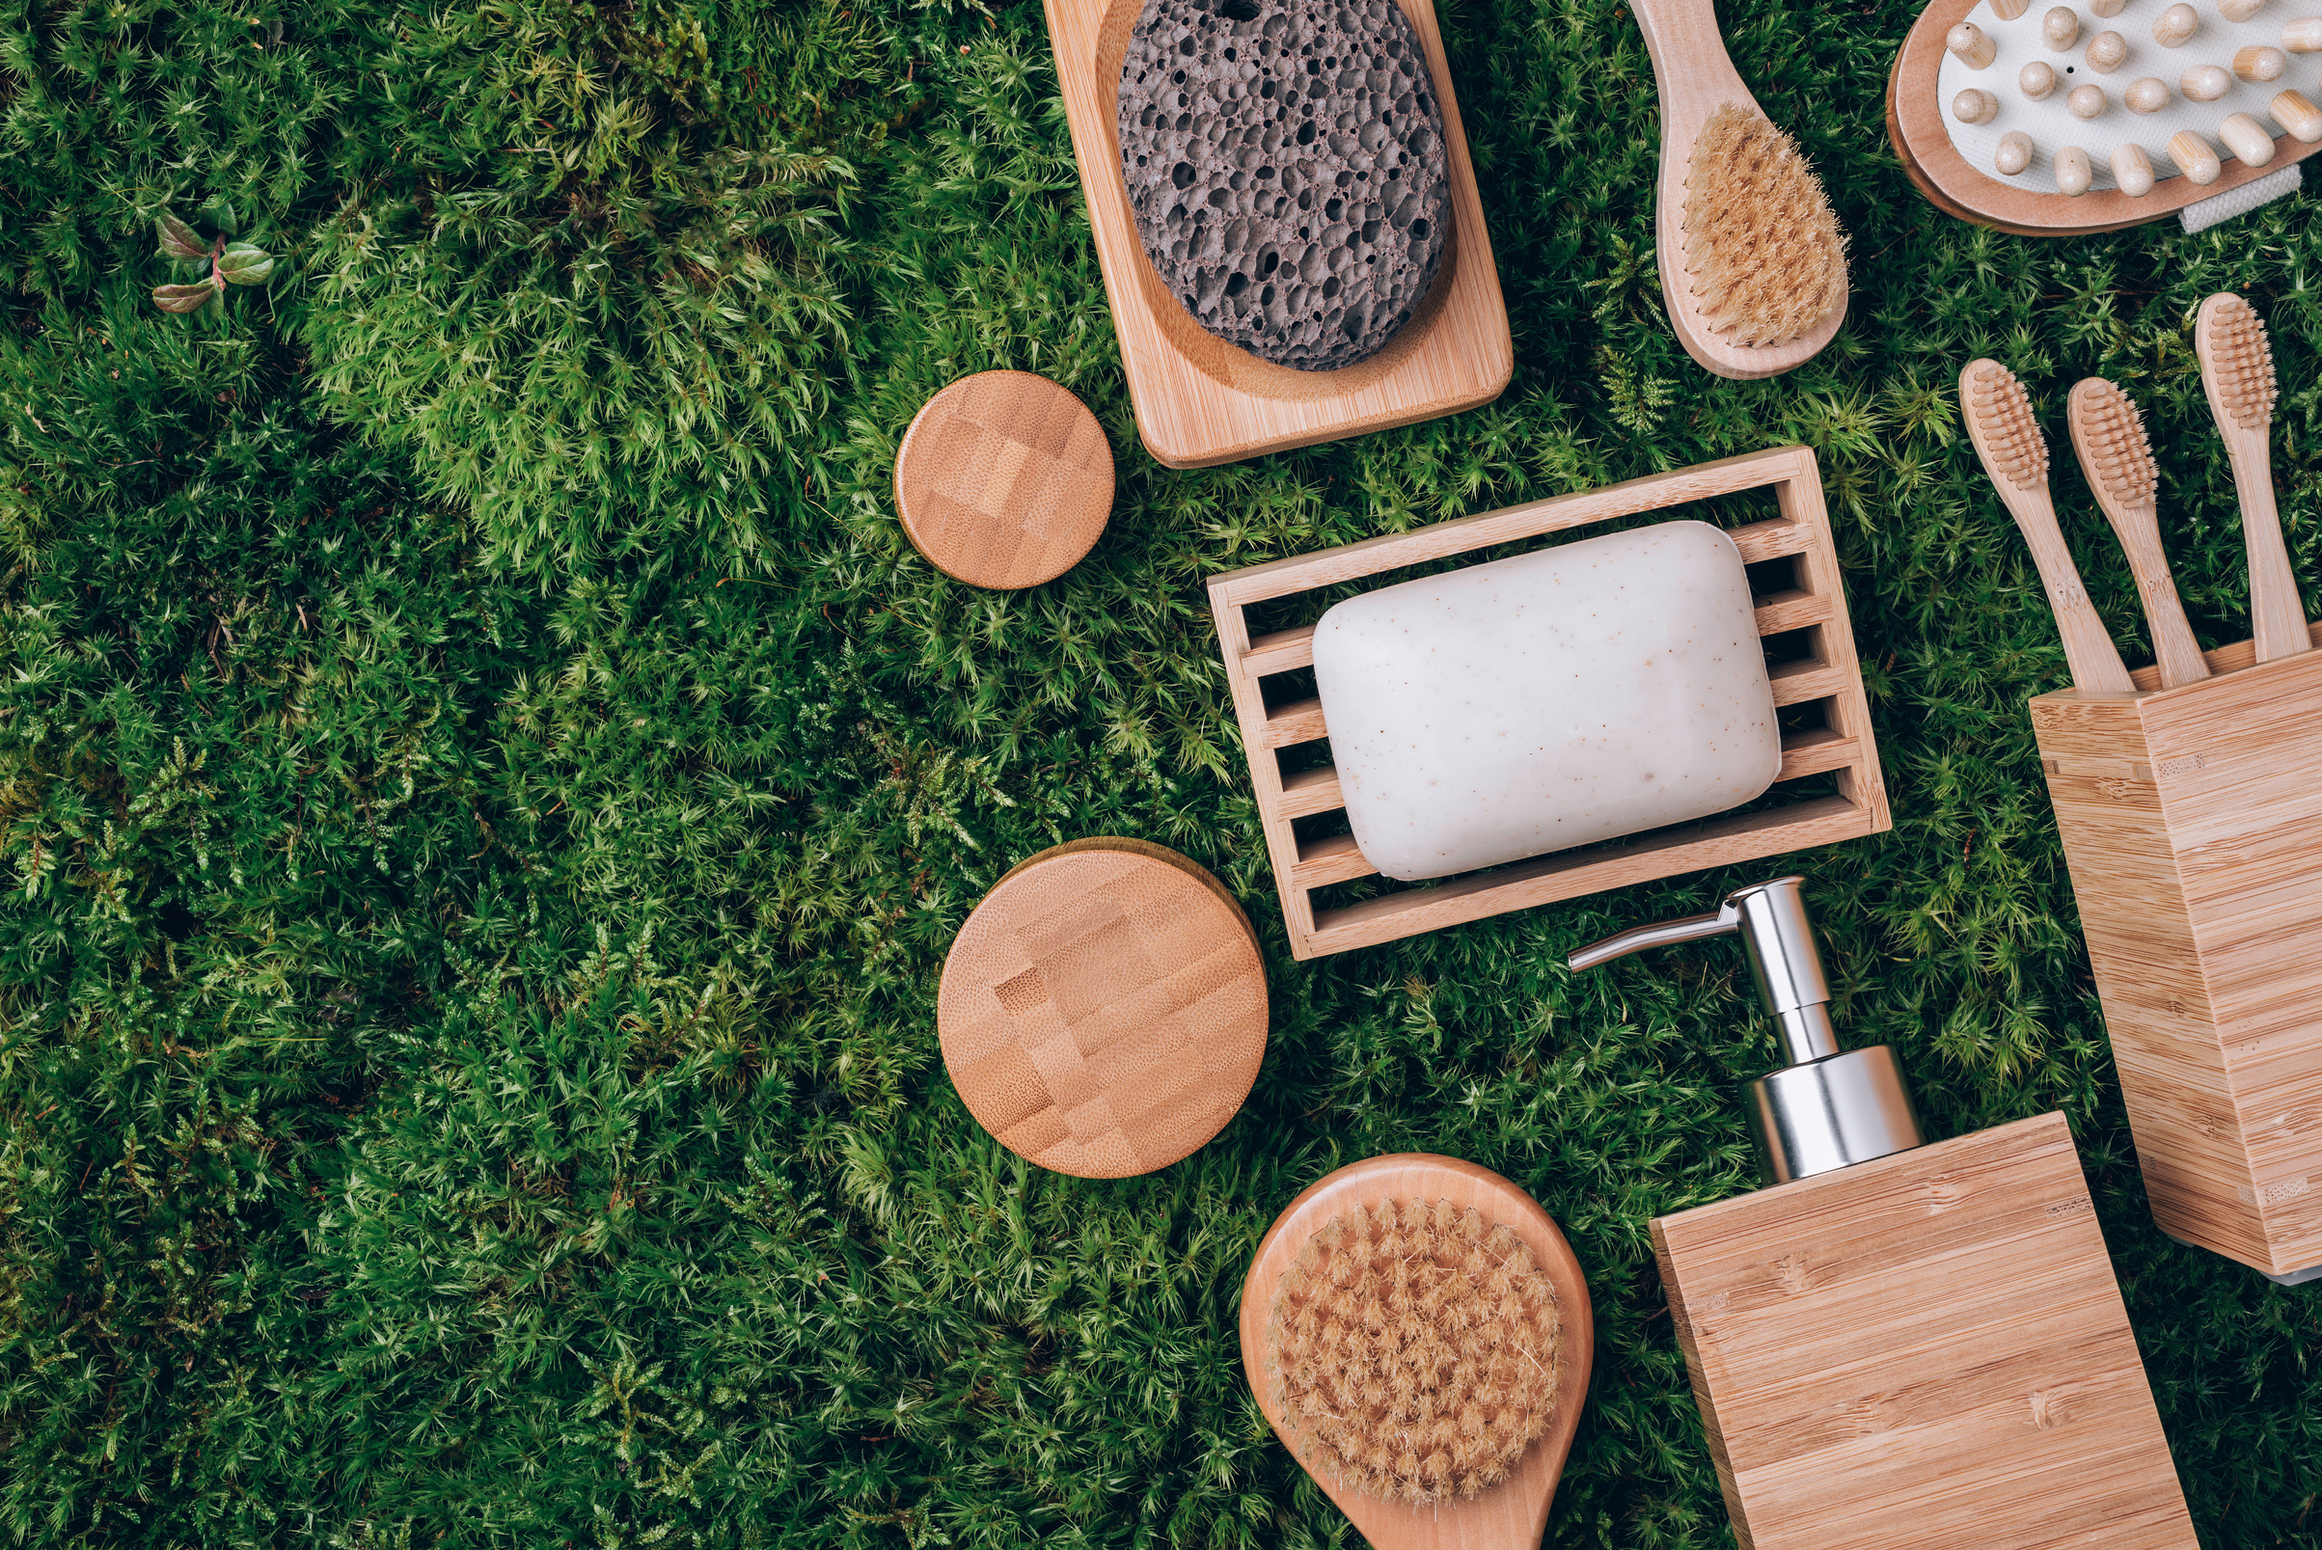


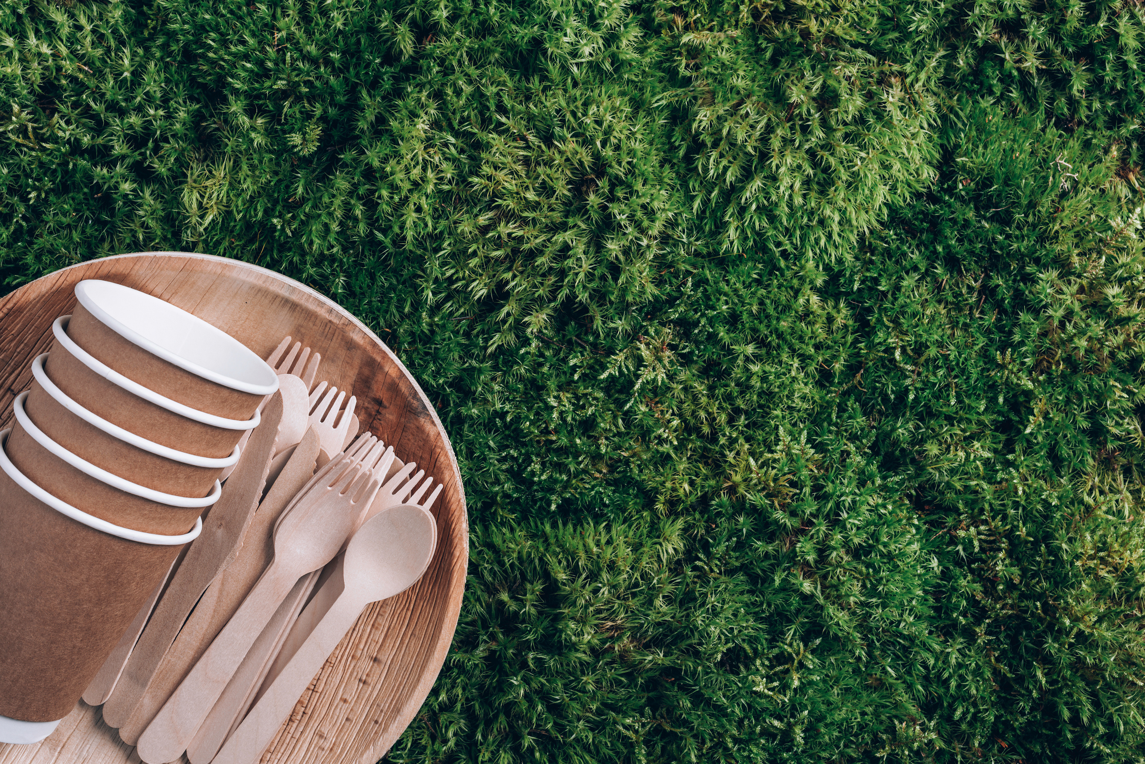
RETHINK YOUR CONSUMPTION
Encourage mindful consumption while briefly explaining the concept. Give an example of responsible shopping, such as buying local and seasonal items and supporting environmentally friendly firms. Mention how important it is to extend the life of your possessions through proper maintenance.
GIGGLING PLATYPUS CO.

Slide 10
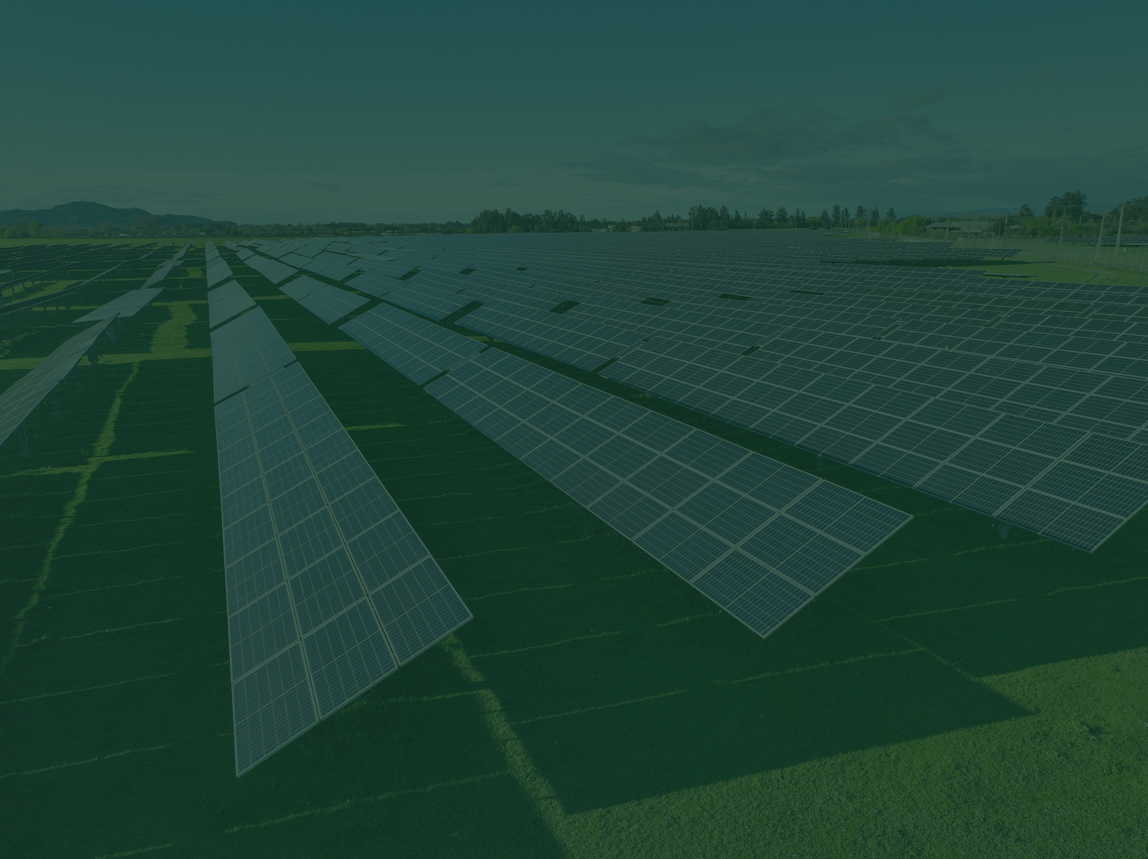
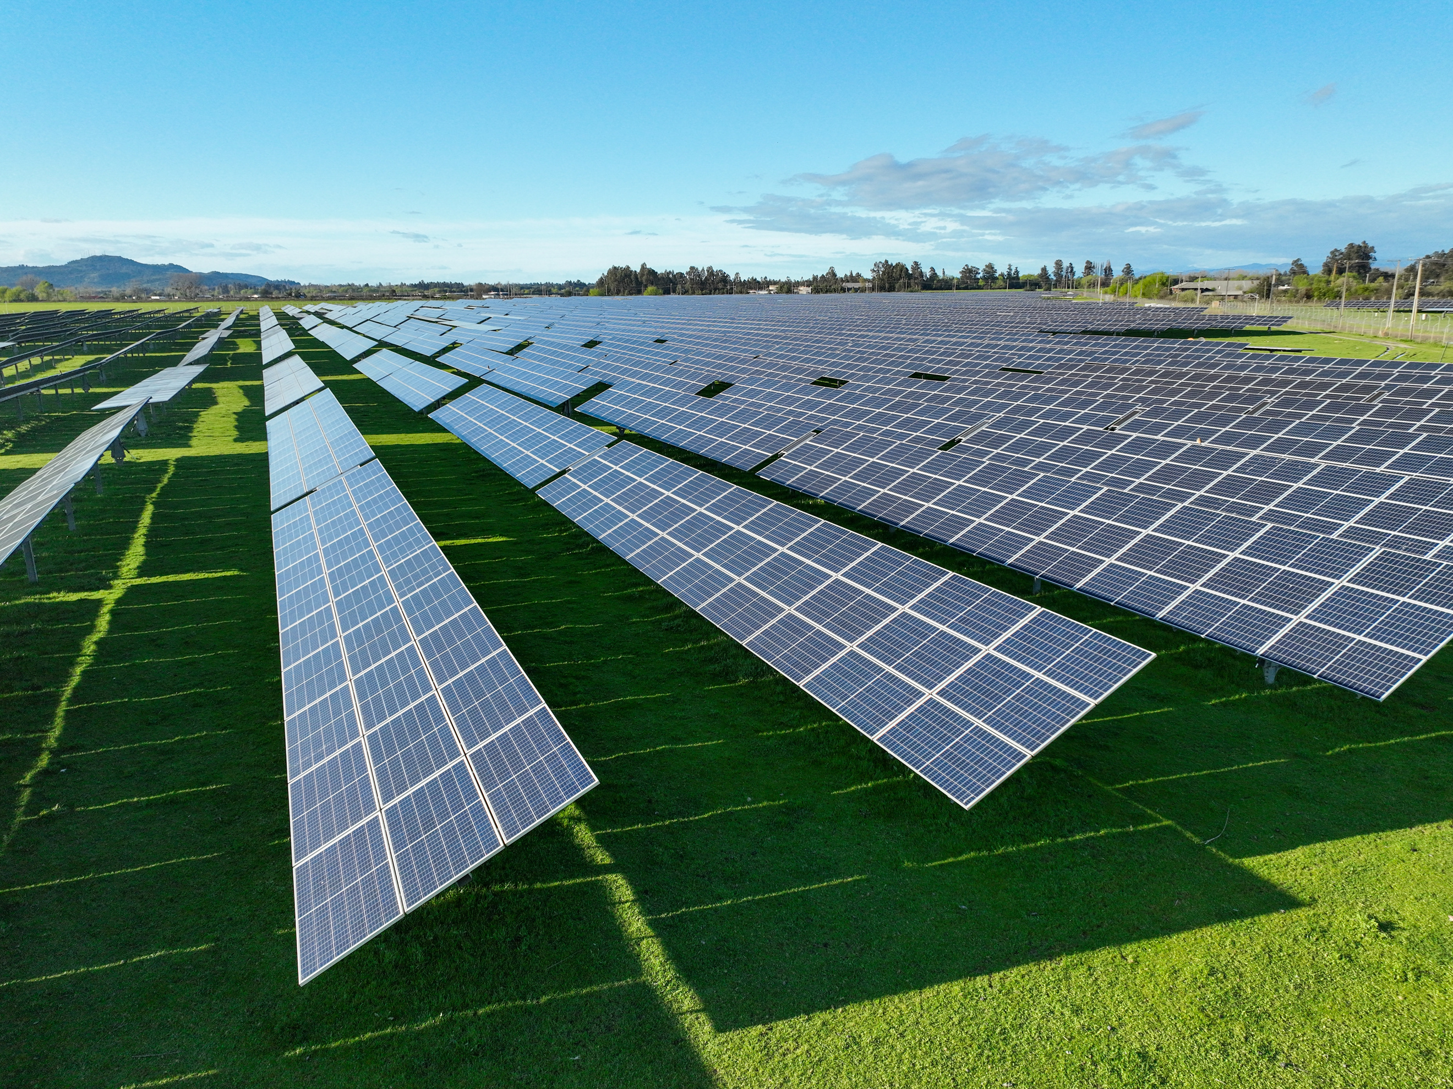
REIMAGINE YOUR ENERGY USE
Explain why we need to go beyond simply conserving energy. Discuss renewable energy sources and how individuals may support the transition to a cleaner energy grid. Include examples, such as installing solar panels if possible.
GIGGLING PLATYPUS CO.

Slide 11


LIVING A GREENER LIFESTYLE
GREEN YOUR TRANSPORTATION
WEAR SUSTAINABLE FASHION
Promote sustainable transportation options in addition to reducing private vehicle use. Discuss options such as electric vehicles, carpooling, bike-sharing programs, and using public transportation to commute.
Emphasize the significance of the fashion industry's ecological impact. Discuss eco-friendly clothing options such as shopping secondhand, using sustainable fabrics, and caring for your clothes mindfully.

Slide 12



GREEN YOUR HOME ENVIRONMENT
ADVOCATE FOR CHANGE
THE RIPPLE EFFECT
Highlight the importance of individual activity and its positive impact on the environment. Briefly highlight successful environmental efforts or movements.
Offer advice on how to make your home more environmentally friendly. Briefly discuss the use of natural cleaning products, conserving water, and establishing energy-efficient practices.
Encourage your friends to participate in environmental movements and advocacy. Discuss ways to get involved, such as funding environmental organizations or contacting local representatives about environmental issues.

Slide 13

YOUR GREEN ACTION PLAN
To develop Eco-Action for a Healthy Living, start by adopting sustainable habits like reducing waste, conserving energy, and using eco-friendly products. Focus on healthy choices such as eating organic and using natural cleaners. Engage your community through awareness campaigns and local activities like tree planting. Track your progress, adjust strategies, and share your successes to inspire others to embrace a healthier, more sustainable lifestyle.

Slide 14
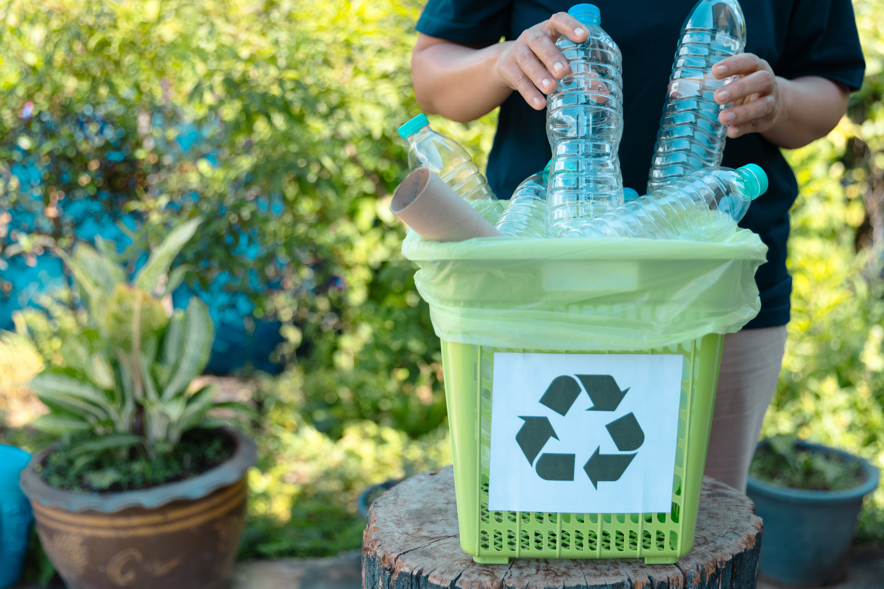
CONCLUSION
Individual choices matter. By incorporating these practices into our daily routines, we can collectively make a significant positive impact. The power lies not just in our own actions but in inspiring others to join the movement. Share your green action plan with friends, family, and your community. Remember, every action, big or small, contributes to a brighter and more sustainable future.

Slide 15
KNOW YOUR EMISSION, TAKE YOUR ACTION
Looking forward to making a healthier life together!

